Slide 1
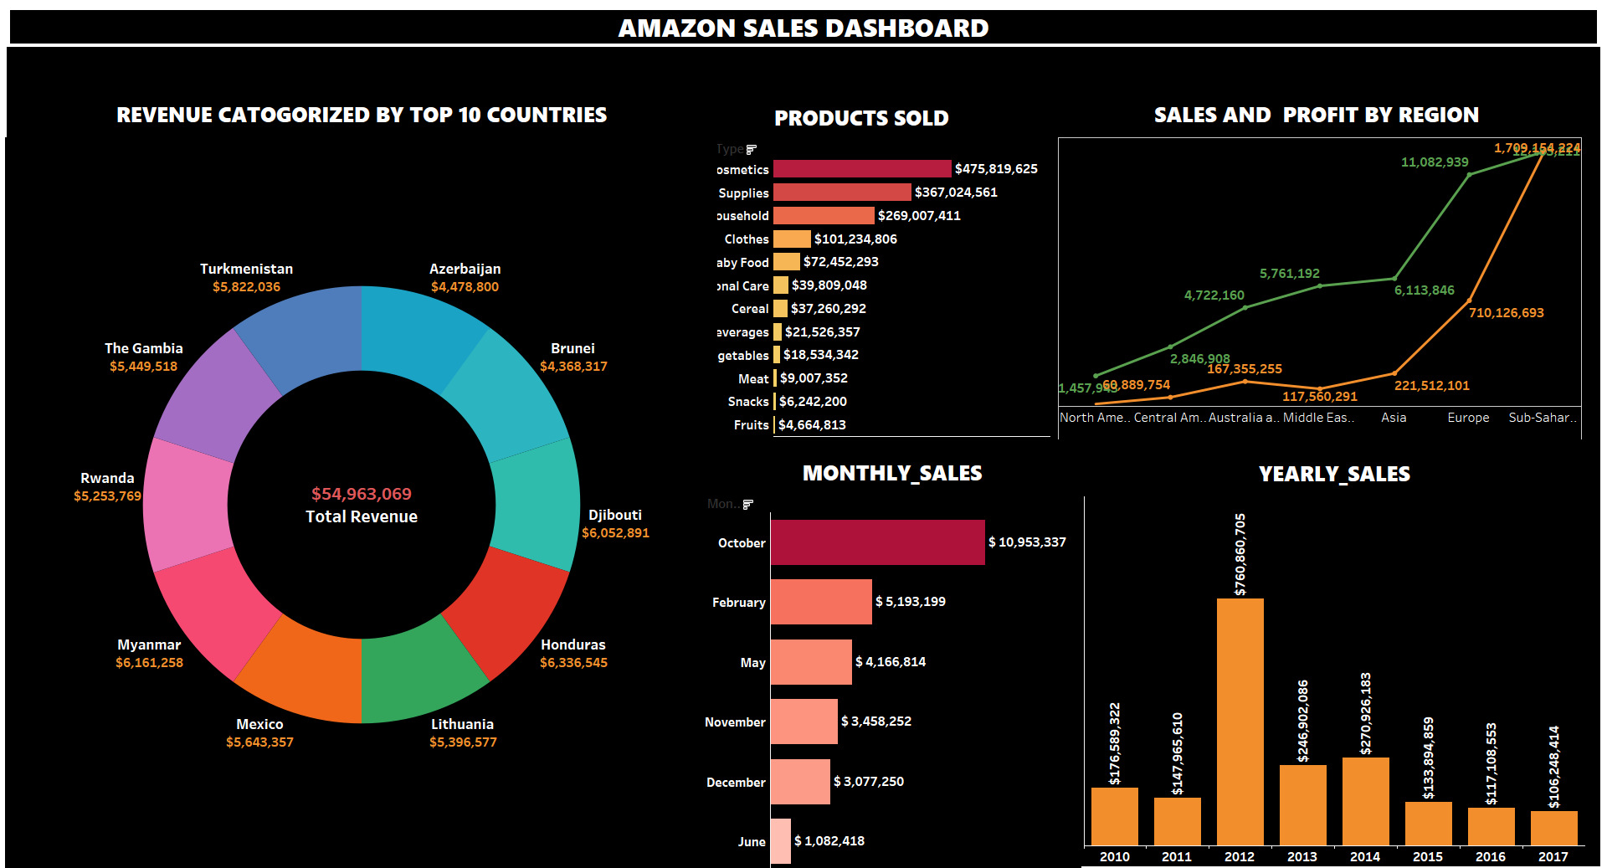
AMAZON SALES DATA ANALYSIS REPORT
BY SHORRYA VERMA

Slide 2
OBJECTIVE
BENEFITS
FINDINGS
Help out to make better business decisions.
Help analyze customer trends and satisfaction, which can lead to new and better products and services.
Gives better insight of customers base.
Helps in easy flow for managing resources
Sales management has gained importance to meet increasing competition and the need for improved methods of distribution to reduce cost and to increase profits. Sales management today is the most important function in a commercial and business enterprise.
Develop a Report by Extracting-Transforming-Loading of data which contains Sales trend with respect to Year, Month, Quarter and find Some relationships through data to understand and Analyze the Facts.

Slide 3
QUICK INSIGHT
﻿A quick insight for 2010 | 2011 | 2012 | 2013 | 2014 | 2015 | 2016 | 2017 amazon sales.
5128K Sales Quantity
137.3B
Total Sales
44.17M
Total Profit

Slide 4
YEARLY SALES
﻿2012 had the highest Revenue at 76M
76 M
Millions
27 M
24 M
17 M
14 M
13 M
11 M
10 M

Slide 5
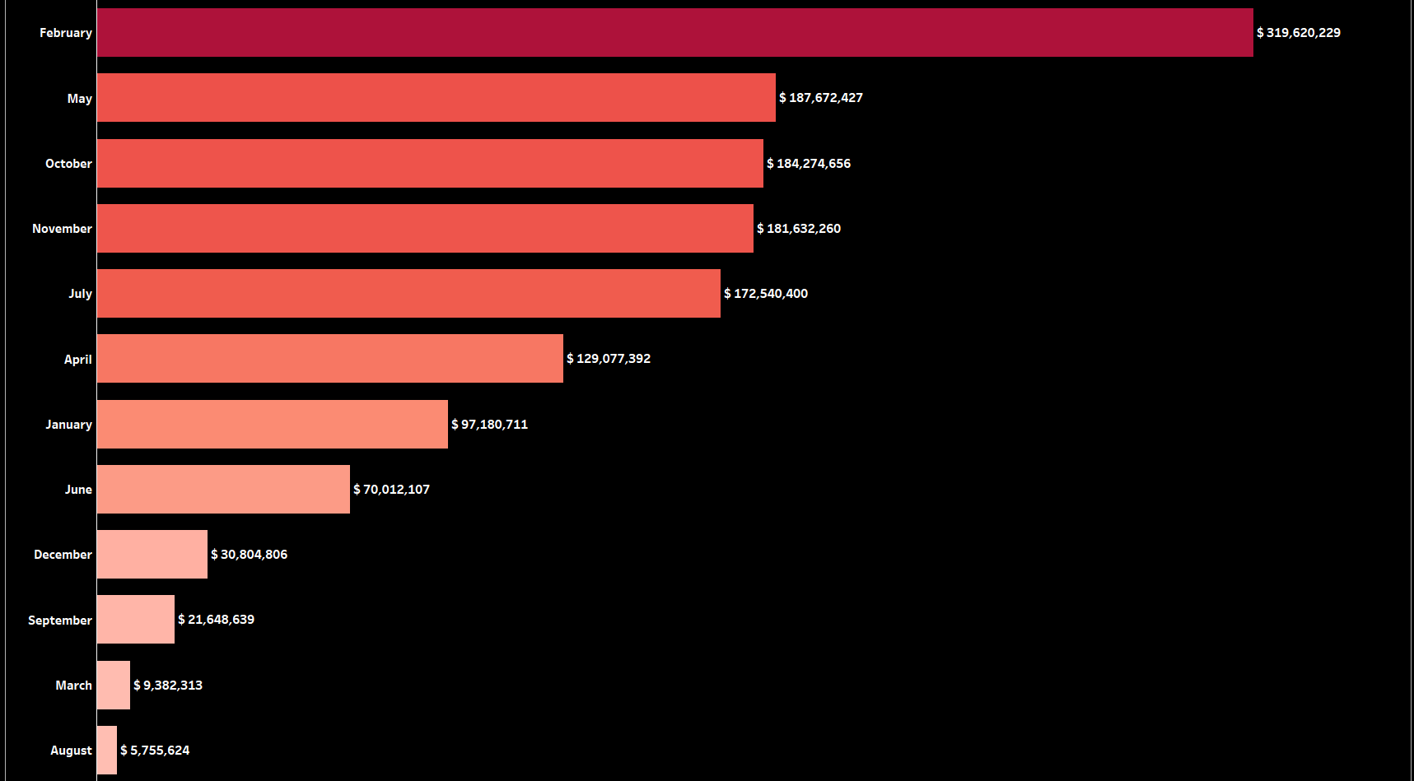
MONTHLY SALES
The sales in February has the highest sales

Slide 6
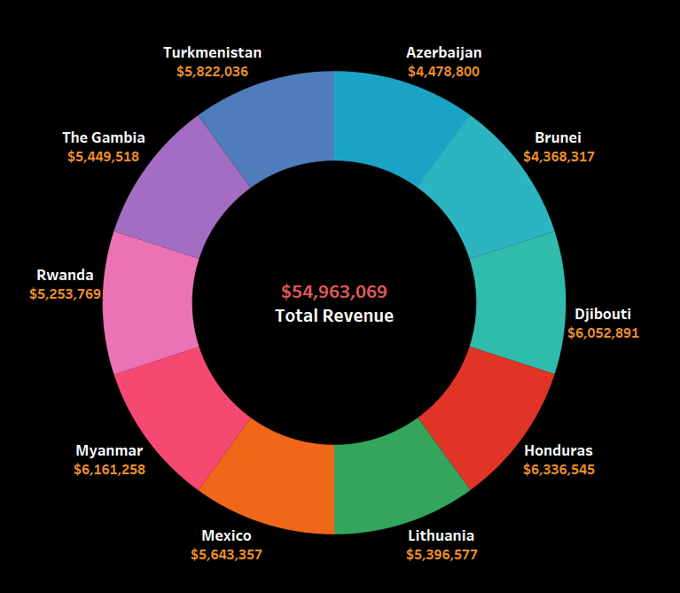
REVENUE CATOGORIZED BY THE TOP 10 COUNTRIES
Honduras generated the highest revenue of $ 63B, followed by Myanmar and Djibouti

Slide 7
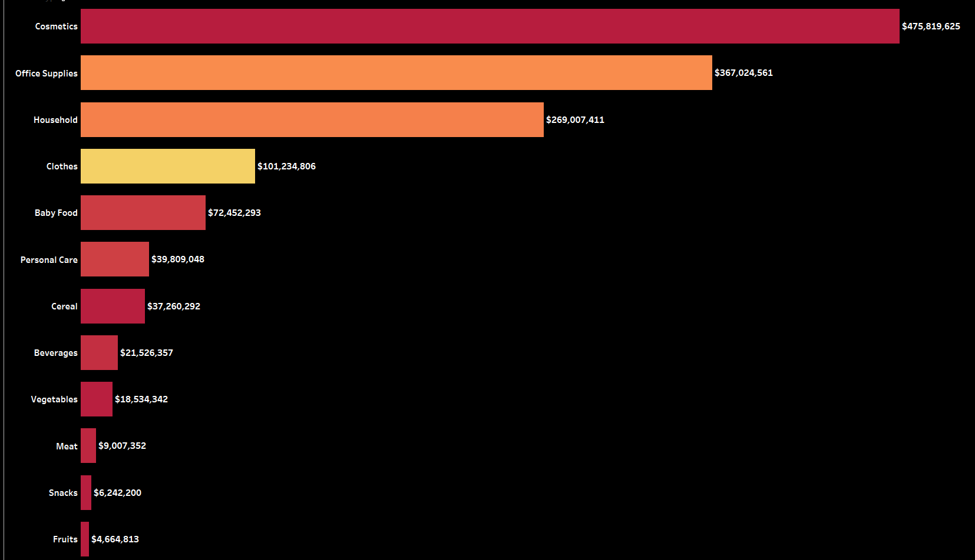
REVENUE CATOGORIZED BY THE PRODUCTS
﻿The Cosmetics and Office Supplies are the products with highest sales.

Slide 8
CONCLUSION
2012 had the highest Revenue at 76M
If we observe the monthly insights of the sales are at their peak in February, May and October and are low in September, March & August. Amazon can come up with some good discounts and offers to generate high revenue.
The sales for the Honduras are highest among all countries and lowest in Brunei.
The Cosmetics & Office appliances are the highest selling products in domestic and international markets.

Slide 9
THANK YOU

